Slide 1
Classification and Prediction

Slide 2
Classification and Prediction
Two forms of data analysis.
Used to extract models describing important data classes or to predict future data trends.
Help provide us with a better understanding of the data at large.

Slide 3
What Is Classification?
Categorize bank loan applications as either safe or risky
A marketing manager at AllElectronics needs data analysis to help guess whether a customer with a given profile will buy a new computer.
A medical researcher wants to analyze breast cancer data in order to predict which one of three specific treatments a patient should receive.
Classification -a model or classifier is constructed to predict categorical labels,
“safe” or “risky” for the loan application data;
“yes” or “no” for the marketing data;
or “treatment A,” “treatment B,” or “treatment C” for the medical data
Prediction - predicts a continuous-valued function, or ordered value(numeric prediction)
predict the expenditures in dollars of potential customers on computer equipment given their income and occupation.

Slide 4
Classification
A 2 step process.
Learning step(or training phase)- a classifier is built describing a predetermined set of data classes or concepts.
A classification algorithm builds the classifier by analyzing or “learning from” a training set made up of database tuples and their associated class labels.
A tuple, X, is represented by an n-dimensional attribute vector, X = (x1, x2, : : : , xn)
Each tuple, X, is assumed to belong to a predefined class as determined by another database attribute called the class label attribute.
The individual tuples making up the training set are referred to as training tuples.
Supervised learning - Because the class label of each training tuple is provided.

Slide 5
Classification
Second step- the model is used for classification.
First, the predictive accuracy of the classifier is estimated.
A test set is used, made up of test tuples and their associated class labels which are randomly selected from the general data set.
The accuracy of a classifier on a given test set is the percentage of test set tuples that are correctly classified by the classifier
Supervised learning(class label provided) vs Unsupervised learning (or clustering, class label of each training tuple is not known)

Slide 6
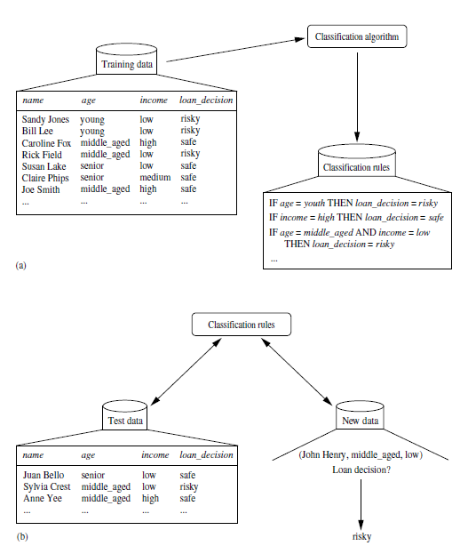

Slide 7
What is Prediction?
No “class label attribute” because the attribute for which values are being predicted is continuous-valued (ordered) rather than categorical (discrete-valued and unordered)- predicted attribute
Predict the amount (in dollars) that would be “safe” for the bank to give as loan for an applicant.
Replace the categorical attribute, loan decision, with the continuous-valued loan amount as the predicted attribute

Slide 8
Prediction
Prediction and classification also differ in the methods that are used to build their respective models.
The training set used to build a predictor should not be used to assess its accuracy.
An independent test set should be used instead.
The accuracy of a predictor is estimated by computing an error based on the difference between the predicted value and the actual known value of y for each of the test tuples, X.
There are various predictor error measures.

Slide 9
Issues Regarding Classification and Prediction
Preparing the Data for Classification and Prediction
Data cleaning - preprocessing of data in order to remove or reduce noise and the treatment of missing values.
Relevance analysis-redundancy and irrelevant attributes
Correlation analysis, attribute subset selection
Data transformation and reduction
Normalization- scaling all values for a given attribute so that they fall within a small specified range, such as -1.0 to 1.0, or 0.0 to 1.0.

Slide 10
Issues Regarding Classification and Prediction
Comparing Classification and Prediction Methods
Accuracy-
The accuracy of a classifier refers to the ability of a given classifier to correctly predict the class label of new or previously unseen data (i.e., tuples without class label information).
The accuracy of a predictor refers to how well a given predictor can guess the value of the predicted attribute for new or previously unseen data.
Accuracy can be estimated using one or more test sets that are independent of the training set.
Estimation techniques - cross-validation and bootstrapping.
Speed: The computational costs involved in generating and using the given classifier or predictor.
Robustness: The ability of the classifier or predictor to make correct predictions given noisy data or data with missing values.
Scalability: The ability to construct the classifier or predictor efficiently given large amounts of data.
Interpretability: The level of understanding and insight that is provided by the classifier or predictor.

Slide 11
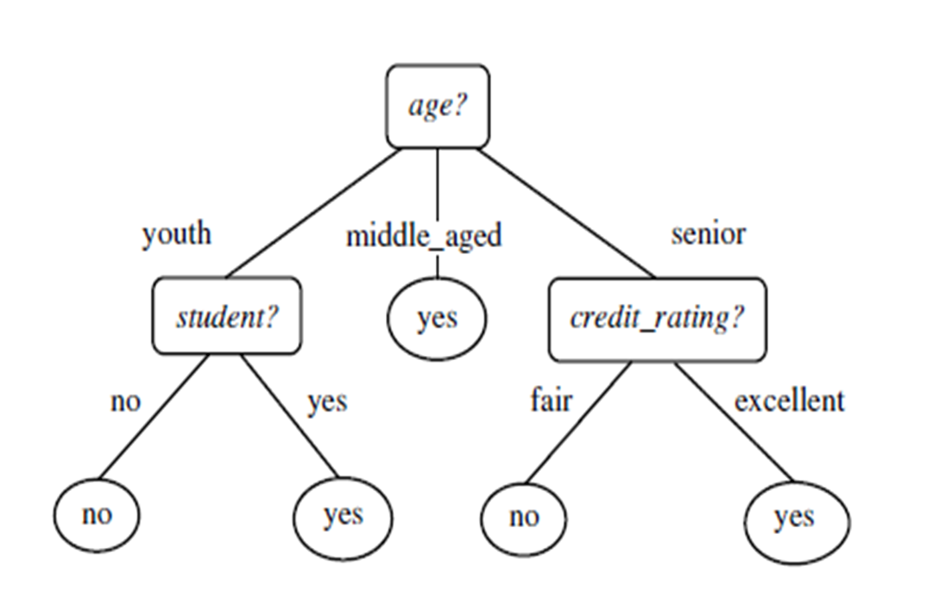
Classification by Decision Tree Induction
Learning of decision trees from class-labeled training tuples.
A decision tree is a flowchart-like tree structure, where
each internal node denotes a test on an attribute
each branch represents an outcome of the test, and
each leaf node holds a class label

Slide 12
Classification by Decision Tree Induction
“How are decision trees used for classification?”
Given a tuple, X, for which the associated class label is unknown, the attribute values of the tuple are tested against the decision tree.
A path is traced from the root to a leaf node, which holds the class prediction for that tuple.
Decision trees can easily be converted to classification rules.
“Why are decision tree classifiers so popular?”
The construction does not require any domain knowledge or parameter setting, and therefore is appropriate for exploratory knowledge discovery.
Decision trees can handle high dimensional data. Their representation of acquired knowledge in tree form is intuitive and generally easy to assimilate by humans.
The learning and classification steps of decision tree induction are simple and fast.
Decision tree classifiers have good accuracy(generally). Success depend on the data at hand.
Used for classification in many application areas, such as medicine, manufacturing and production, financial analysis, astronomy, and molecular biology.

Slide 13
Decision Tree Induction
During the late 1970s and early 1980s, J. Ross Quinlan, a researcher in machine learning, developed a decision tree algorithm known as ID3 (Iterative Dichotomiser), later extended to C4.5 -a benchmark to which newer supervised learning algorithms are often compared
CART(1984)-Classification and Regression Trees) by a group of statisticians, described the generation of binary decision trees.
ID3, C4.5, and CART adopt a greedy (i.e., nonbacktracking) approach in which decision trees are constructed in a top-down recursive divide-and-conquer manner.
ID3 and CART were invented independently of one another at around the same time, yet follow a similar approach for learning decision trees from training tuples.
These two cornerstone algorithms for decision tree induction.

Slide 14
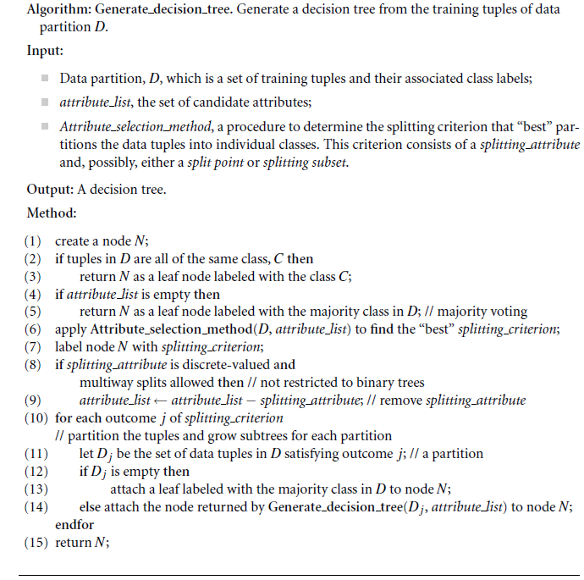

Slide 15
Decision Tree Induction
Three parameters: D(data partition), attribute list, and Attribute selection method.
Initially D is the complete set of training tuples and their associated class labels.
Attribute list is a list of attributes describing the tuples
Attribute selection method employs an attribute selection measure, such as information gain or the gini index
The tree starts as a single node, N
If the tuples in D are all of the same class, then node N becomes a leaf and is labeled with that class
Otherwise, the algorithm calls Attribute selection method to determine the splitting criterion.
The node N is labeled with the splitting criterion
Discrete-valued
Continuous-valued
Discrete-valued and a binary tree must be produced

Slide 16
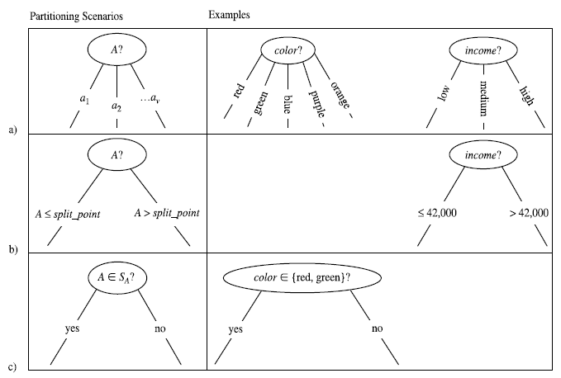
A is discrete-valued
A is continuous-valued, A<= split point and A > split point
c) A is discrete-valued and a binary tree must be produced

Slide 17
Uses the same process recursively to form a decision tree for the tuples
Recursive partitioning stops only when
All of the tuples in partition D (represented at node N) belong to the same class
There are no remaining attributes on which the tuples may be further partitioned
There are no tuples for a given branch, that is, a partition D_{j} is empty
The resulting decision tree is returned

Slide 18
Attribute Selection Measures
Selecting the splitting criterion that “best” separates a given data partition, D, of class-labeled training tuples into individual classes
Also known as splitting rules
Three popular attribute selection measures—
Information gain
Gain ratio
Gini index.

Slide 19

Information gain
Let node N represent or hold the tuples of partition D.
The attribute with the highest information gain is chosen as the splitting attribute for node N.
This attribute minimizes the information needed to classify the tuples in the resulting partitions and reflects the least randomness in these partitions.
The approach minimizes the expected number of tests needed to classify a given tuple and guarantees that a simple tree is found.
The expected information needed to classify a tuple in D is given by
p_{i} is the probability that an arbitrary tuple in D belongs to class C_{i} and is estimated by |C_{i,D}|/|D|
Info(D) is also known as the entropy of D.

Slide 20


To partition the tuples in D on some attribute A having v distinct values, {a₁, a₂,…, a_{v}}.
If A is discrete-valued, these values correspond directly to the v outcomes of a test on A.
Attribute A can be used to split D into v partitions or subsets, {D₁, D₂,…, D_{v}},where D_{j} contains those tuples in D that have outcome a_{j} of A.
These partitions would correspond to the branches grown from node N.
Information gain is defined as the difference between the original information requirement (i.e., based on just the proportion of classes) and the new requirement (i.e., obtained after partitioning on A).

Slide 21
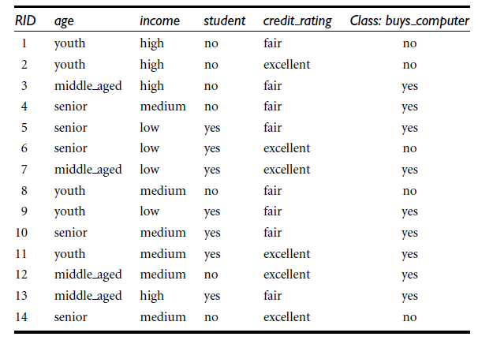
Table presents a training set, D, of class-labeled tuples randomly selected from the AllElectronics customer database.
Each attribute is discrete-valued.
The class label attribute, buys computer, has two distinct values (namely, yes, no); therefore, there are two distinct classes (that is, m = 2).
Let class C1 correspond to yes and class C2 correspond to no.

Slide 22

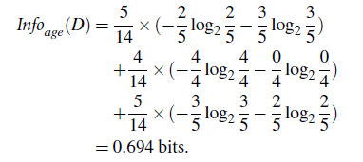
First, compute the expected
information needed to classify a tuple in D:
Next, we need to compute the expected information requirement for each attribute.
Gain(income) = 0.029 bits, Gain(student) = 0.151 bits, and Gain(credit rating) = 0.048 bits.
The attribute with the highest information gain is chosen as the splitting attribute for node N.

Slide 23
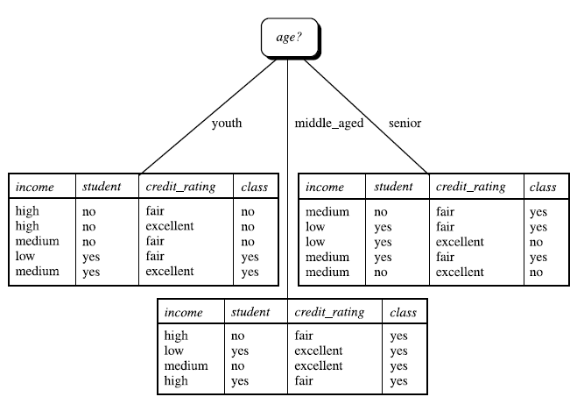
Notes:
https://www.youtube.com/watch?v=coOTEc-0OGw&t=166s

Slide 24
Attribute A is continuous-valued
Eg. we have the raw values for age
Determine the “best” split-point for A, where the split-point is a threshold on A
First sort the values of A in increasing order
The midpoint between each pair of adjacent values is considered as a possible split-point
Given v values of A, then v-1 possible splits are evaluated
The midpoint between the values a_{i} and a_{i+1} of A is (a_{i}+a_{i+1})/ 2
For each possible split-point for A, we evaluate Info_{A}(D), where the number of partitions is 2, that is v = 2 (or j = 1,2)
The point with the minimum expected information requirement for A is selected as the split point for A.
D1 is the set of tuples in D satisfying A<= split point, and D2 is the set of tuples in D satisfying A > split point.

Slide 25
Gain Ratio
Consider an attribute that acts as a unique identifier, such as product_ ID.
A split on product ID would result in a large number of partitions each one containing just one tuple.
Because each partition is pure, the information required to classify data set D based on this partitioning would be Info _{product_ID}(D) = 0.
Therefore, the information gained by partitioning on this attribute is maximal.

Slide 26


C4.5, a successor of ID3, uses an extension to information gain known as gain ratio.
It applies a kind of normalization to information gain using a “split information”
SplitInfo considers the number of tuples having that outcome with respect to the total number of tuples in D.
The attribute with the maximum gain ratio is selected as the splitting attribute

Slide 27
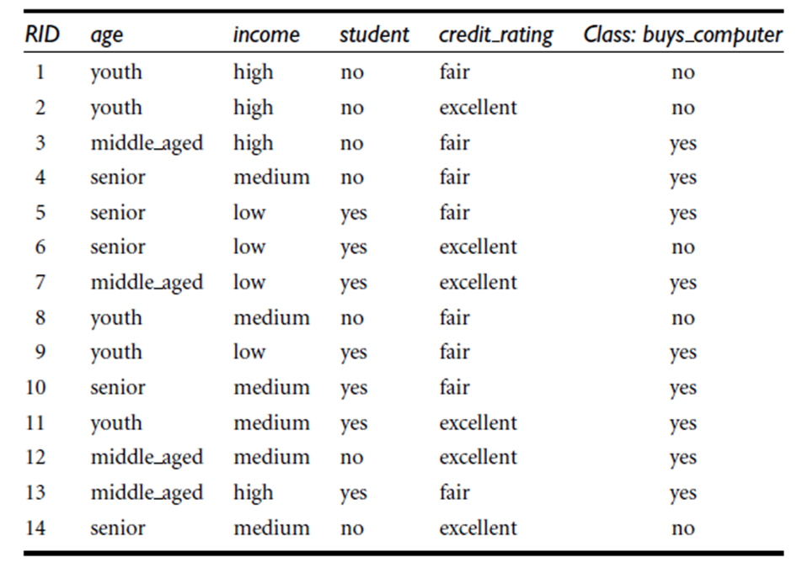
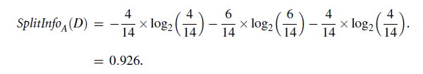
Eg. A test on income splits the data into three partitions, namely low, medium, and high, containing four, six, and four tuples
We have Gain(income) = 0.029
GainRatio(income) = 0.029/0.926 = 0.031.
Notes:
https://www.youtube.com/watch?v=FeGe35iYTXU

Slide 28

Gini index
The Gini index is used in CART.
Measures the impurity of D, a data partition or set of training tuples, as
where pi is the probability that a tuple in D belongs to class C_{i} and is estimated by|C_{i,D}| / |D|. The sum is computed over m classes.
Gini index considers a binary split for each attribute.
A is a discrete-valued attribute having v distinct values, {a₁, a₂, … , a_{v}}
Examine all of the possible subsets that can be formed using known values of A.

Slide 29

Compute a weighted sum of the impurity of each resulting partition.
If a binary split on A partitions D into D1 and D2, the gini index of D given that partitioning is
For a discrete-valued attribute, the subset that gives the minimum gini index for that attribute is selected as its splitting subset.
For continuous-valued attributes, each possible split-point must be considered.

Slide 30
How to build decision tree using Gini index:
Calculate the Gini Index of the entire dataset. This represents the initial level of impurity before any splitting.
Consider each feature and its threshold values. For each combination, calculate the Gini Index of the two resulting child nodes after splitting the data based on that feature and threshold.
Choose the feature and threshold combination that leads to the smallest Gini Index for the child nodes. This indicates the most significant decrease in impurity, resulting in a more homogeneous separation of data points.
Repeat the process recursively on each child node. Use the same approach to select the next split feature and threshold, further minimizing the Gini Index and separating data points based on their class labels.
Continue splitting until a stopping criterion is met. This could be reaching a pre-defined tree depth, minimum data size per node, or a sufficiently low Gini Index at all terminal leaves.

Slide 31

The reduction in impurity that would be incurred by a binary split on a discrete- or continuous-valued attribute A is.
The attribute that has the minimum Gini index is selected as the splitting attribute

Slide 33
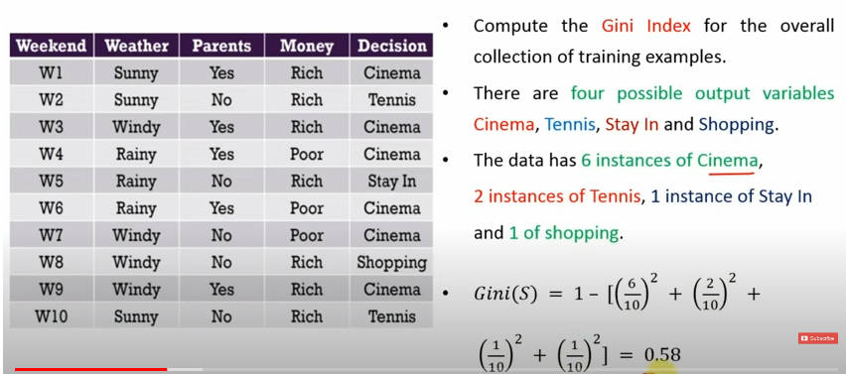

Slide 34
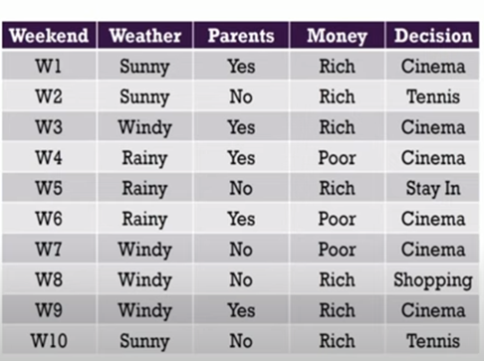
Computation of Gini Index for Money attribute
2 possible values- Rich(7 instances), Poor(3 instances)

Slide 36
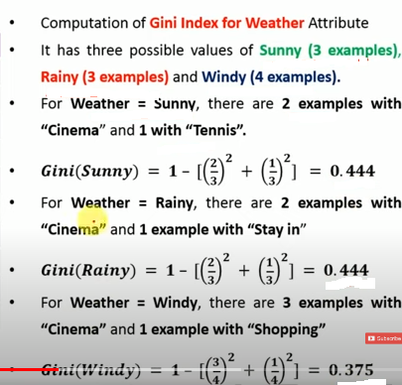

Slide 37
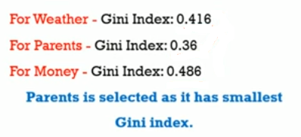

Slide 38
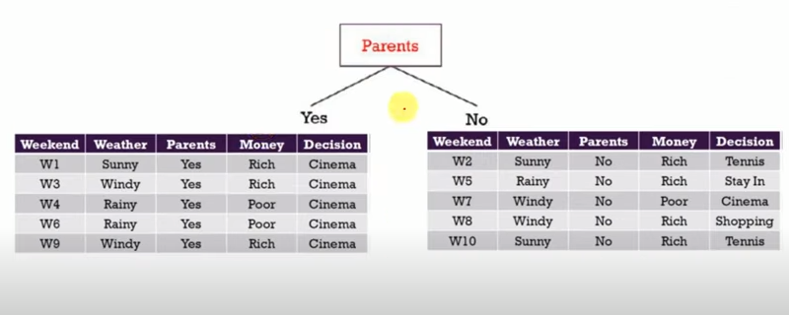

Slide 39
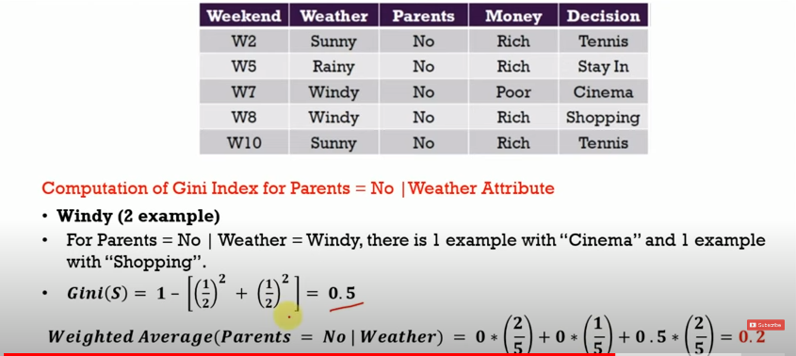

Slide 41
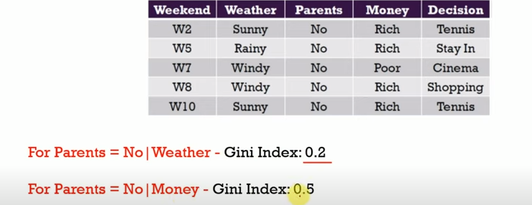


Slide 43
Parents
Yes
No
Cinema
Weather
Windy
Rainy
Sunny
Money
Tennis
Stay In
Rich
Poor
Shopping
Cinema
Notes:
https://www.youtube.com/watch?v=zNYdkpAcP-g

Slide 44
Tree Pruning
Address the problem of overfitting the data(anomalies in the training data due to noise or outliers)
Use statistical measures to remove the least reliable branches
Pruned trees
Smaller
Less complex
Easier to comprehend
Faster
Better at correctly classifying independent test data

Slide 45
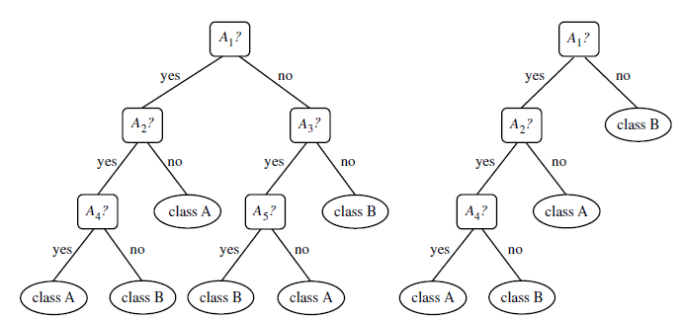

Slide 46
How does tree pruning work?
Two common approaches
Prepruning
Postpruning
Prepruning
A tree is “pruned” by halting its construction early.
Upon halting, the node becomes a leaf.
The leaf may hold the most frequent class among the subset tuples or the probability distribution of those tuples.
Statistical significance, information gain, Gini index-used to assess the goodness of a split.
Split that falls below a pre-specified threshold is halted.
High thresholds could result in oversimplified trees.
Low thresholds could result in very little simplification.
Notes:
Halting construction early (e.g., by deciding not to further split or partition the subset of training tuples at a given node).

Slide 47
Postpruning
Removes subtrees from a “fully grown” tree.
A subtree at a given node is pruned by removing its branches and replacing it with a leaf.
The leaf is labeled with the most frequent class among the subtree being replaced.
The cost complexity pruning algorithm used in CART is an example of the postpruning approach.

Slide 48
Cost complexity pruning algorithm
Considers the cost complexity of a tree to be a function of the number of leaves in the tree and the error rate of the tree.
Error rate is the percentage of tuples misclassified by the tree.
Starts from the bottom of the tree
For each internal node, N, it computes the cost complexity of the subtree at N, and the cost complexity of the subtree at N if it were to be pruned.
If pruning the subtree at node N would result in a smaller cost complexity, then the subtree is pruned.
A pruning set of class-labeled tuples is used to estimate cost complexity which is independent of the training set.
The smallest decision tree that minimizes the cost complexity is preferred.

Slide 49
Pessimistic pruning
Also uses error rate estimates to make decisions regarding subtree pruning
Does not use a prune set but uses the training set itself.
Decision trees can suffer from repetition and replication
Repetition occurs when an attribute is repeatedly tested along a given branch of the tree.
In replication, duplicate subtrees exist within the tree
Solve by
Multivariate splits
Use rules, instead of decision trees

Slide 50
